Slide 1
Final Project Part B
Brendan O’Connor

Slide 2
Approach
In the main this project didn’t differ from the first part. What was different was the parameters were fixed based on the results from part A. Then these configurations were used to produce and train 40 individual networks (1 for each subject). Pattern net was used as the classification head to determine the degree of belief that the given image is the same as the the individual it was trained for. Once each network was trained the training and test data were separately used to score each image and all of the scores and labels were combined into their respective category matrix to produce the final ROCs.

Slide 3
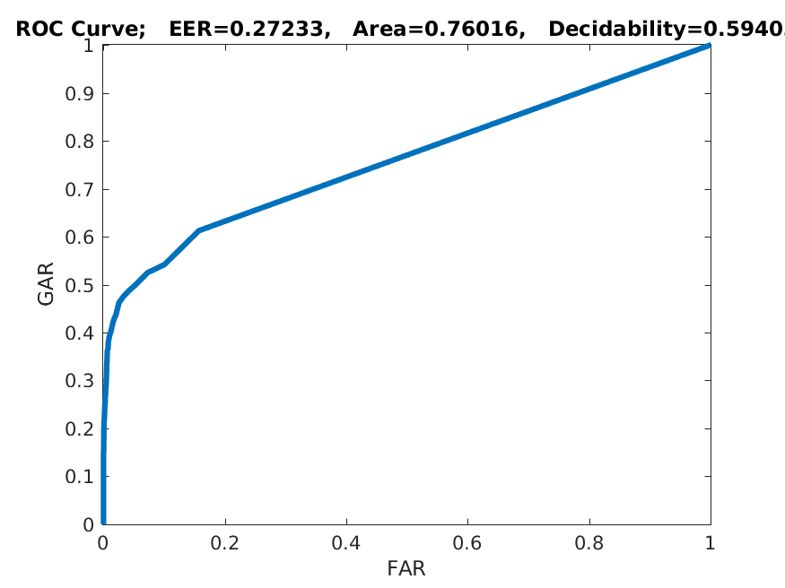
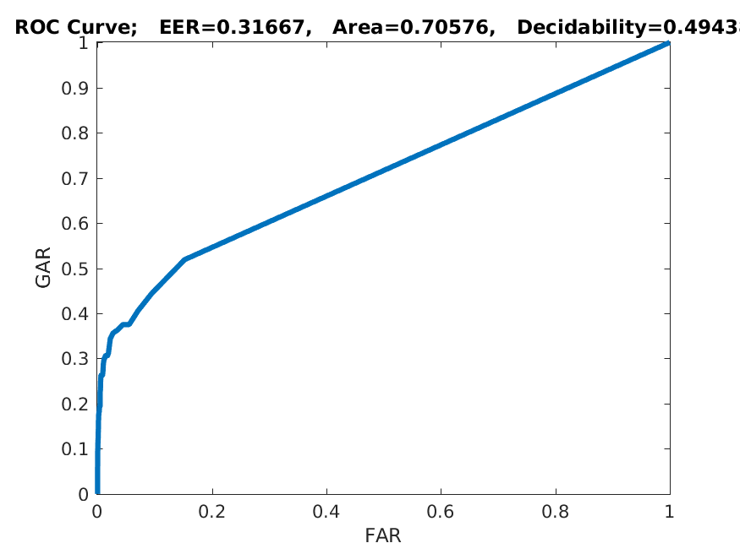
Results
Training Testing

Slide 4
Results - Discussion
We see that the training and the testing results are very similar with the training results, obviously, fairing better. We also notice an interesting pattern. Compared to previously observed ROC curves these are unique in that they “turn the curve”/”bend” at a lower point, indicating that they are less adept at classifying the data, but also after a certain point it linearly increases to one in such a fashion as a random guessing curve. This indicates the given information (pictures) is less effective (lower curve) and limited (at a certain point it is just linear).

Slide 5
Committee Approach
The committee approach is largely the same as the first. It differs in there were two networks (same configurations for both) trained for each subject and then the training and testing data were shown to both and the scores averaged. The scores and labels were combined into one large matrix (as before) and the resulting ROC curves were produced.

Slide 6
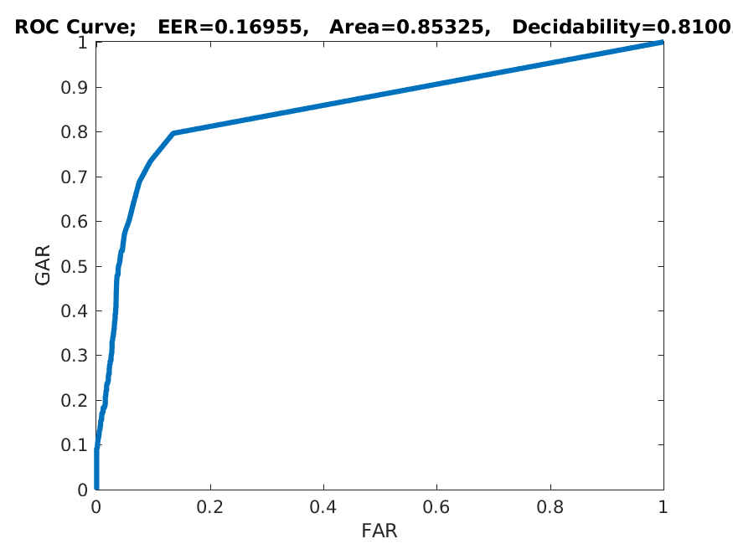
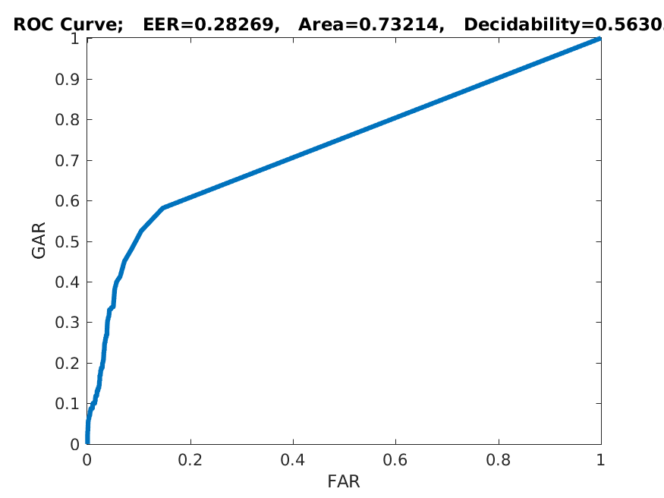
Committee Results
Train Test

Slide 7
Committee Results Discussion
We see that the nature of the curves are largely the same as the single network result. The results for training and testing were both improved (although training more so than testing). It seems the only real difference is that the “bend” occurs higher indicating by averaging the results from two networks we had more information to make a better decision.

